Slide 1

Power
By
Dr.Rohit Lorenzo
Assistant Professor Sr. Grade -1
School of Electronics Engineering (SENSE)

Slide 2
Talk Outline
Motivation - Why Low Power
Sources of power dissipation
Why Leakage Power is Important
Impact of Process parameter variation
Mechanism Of Leakage components

Slide 3
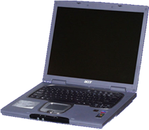


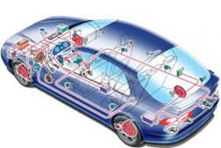
Power Dissipation
Today: power dissipation is a main problem
High Power dissipation leads to
Higher weight (batteries)
Reduced mobility
High efforts for cooling
Increasing operational costs
Reduced reliability

Slide 4
Motivation - Why Low Power
Changing Trend
Until recently performance has been synonyms with circuit speed or processing Power e.g. MIPS
Earlier power consumption were of secondary concern
In Nanometer technology power has become a most important issue because of
Increasing transistor count
Higher speed of operation
Greater device leakage current
Increased process parameter variability due to aggressive scaling has created problem in reliability & Testing

Slide 5
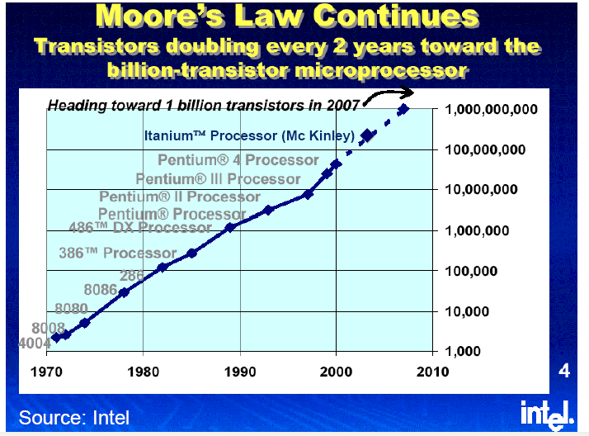
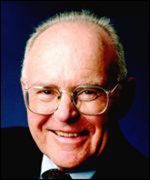
Why Low Power

Slide 6
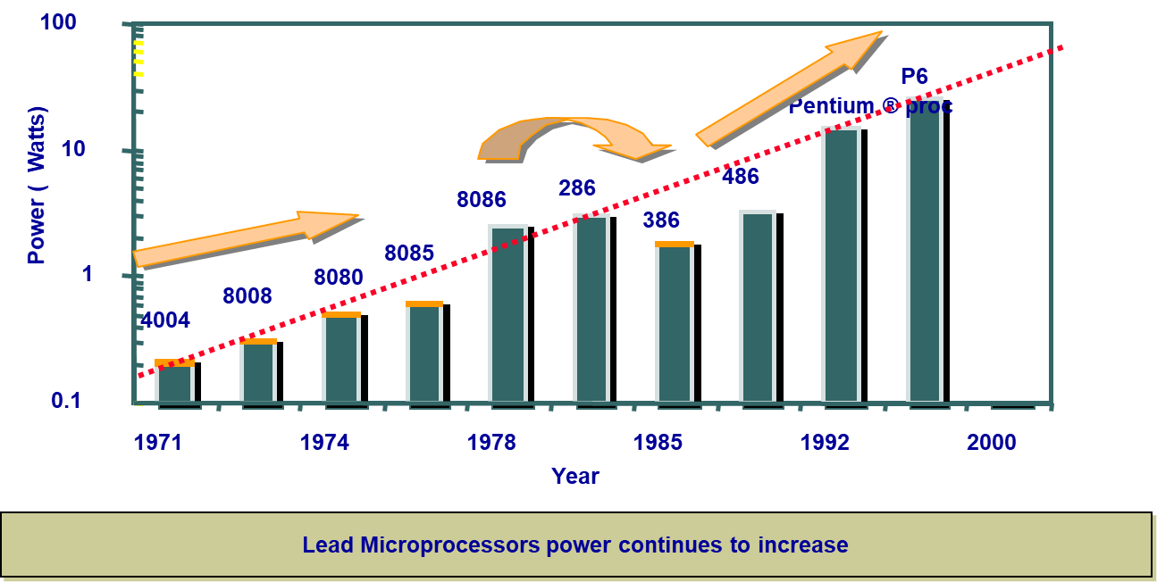
Why Low Power

Slide 7
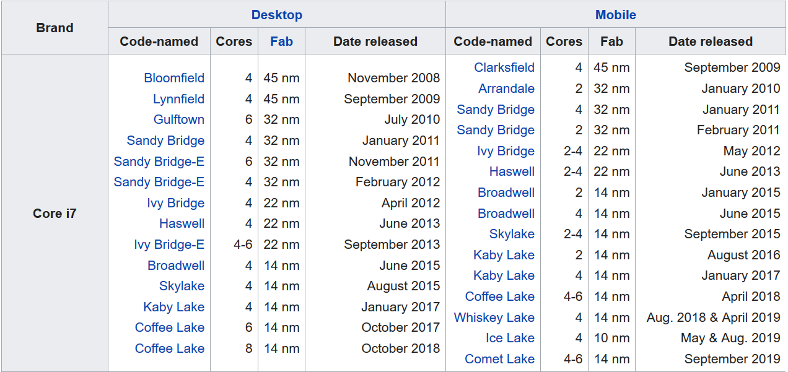
Latest Processor

Slide 8
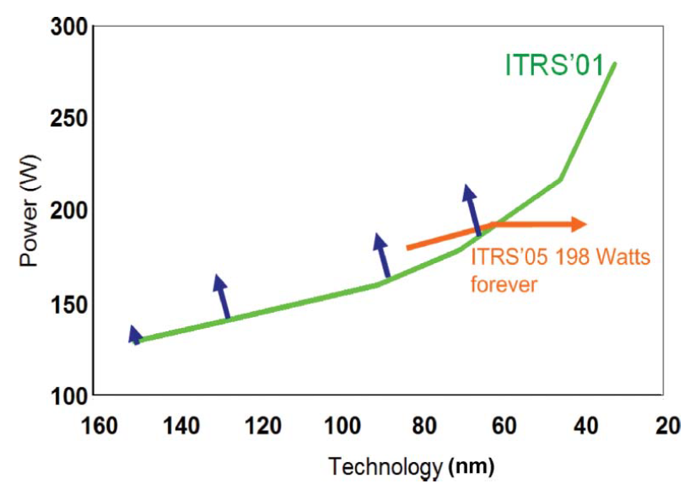
Increased Power Dissipation in DSM
As the device dimension shrink down power goes on increasing in deep sub micron technology (DSM).

Slide 9
Packaging and Cooling Cost
High performance processor Consumes heavy power .
Cost associated with packaging and cooling is prohibitive.
Low power methodology to be Used to reduce the cost of Packaging & cooling.

Slide 10
Portable System
Increasing customer demand for handheld battery operated devices such as cell phone,tablet and laptop etc.
Mobile phone with limitless functionality & limitless power supply is the requirement
Growth rate of these portable equipment is very high
All these devices are battery operated , battery life is of primary concern
Unfortunately, battery technology has not kept up the energy requirement of the portable equipment

Slide 11
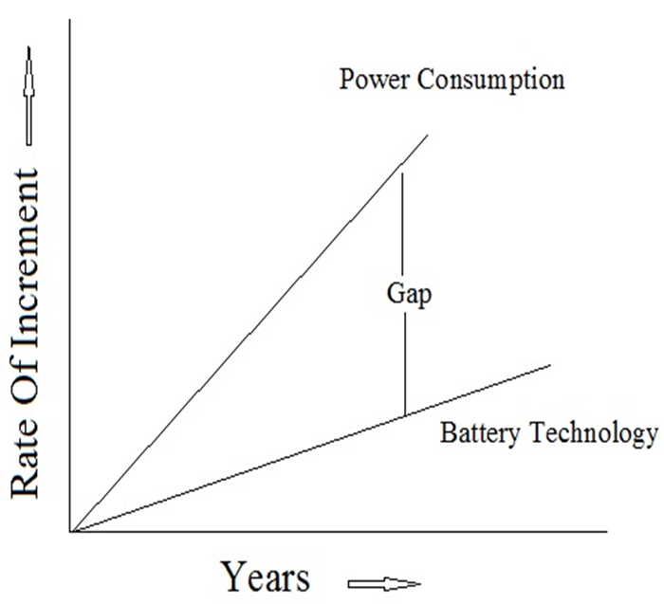
Advantages & Disadvantages
Commercial success of these products depends upon on size ,weight , cost , computing
power and battery life.
Low Power design Methodology Is very important to make them Commercially viable.

Slide 12
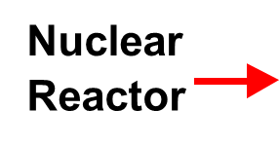

Increasing Power Density
Source: Intel®
10000
Rocket
Nozzle
1000
100
Power Density (W/cm2)
8086
10
4004
P6
8008
8085
386
Pentium®
8080
286
486
1
1970
1980
1990
2000
2010
Year

Slide 13
Environment
According to an estimate of the U.S environmental protection agency (EPA) , 80% of power consumption by office equipment are due to computing equipment and a large part from unused equipment
Power is dissipated mostly in the form of heat .The cooling techniques , such as AC transfers the heat to the environment
To reduce adverse effect on environment efforts such as EPA’s energy star program leading to power management standard for desktops and laptops has emerged

Slide 14
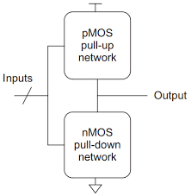
CMOS Technology of Choice
Advantages
^{Ease of Fabrication}
^{Good noise Margin}
^{Robust}
^{Lower Switching Activity}
Good input and output decoupling
^{No charge Sharing problem}
Availability of matured logic and synthesis tool.

Slide 15
Continue….
Disadvantage
Larger number of transistor (larger chip area & delay)
Weak Output driving capability
Larger number of standard cell required substantial engineering effort
for technology mapping
Glitching power dissipation
Short circuit power dissipation

Slide 16
Sources of Power Dissipation
Dynamic Power (Active Mode)
Switching power
Glitching power
Short circuit power
Static Power (Stand by Mode)
Diode leakage current
Sub-threshold leakage current
Gate leakage current

Slide 17
Power Dissipation CMOS Equation
P = α f C_{L} V_{DD}² + V_{DD} I_{peak} (P_{0→1} + P_{1→0} ) + V_{DD} I_{leak}
Dynamic power
(≈ 30 - 50% today and decreasing relatively)
Short-circuit power
(≈ 10 % today and decreasing absolutely)
Leakage(Static) power
(≈ 20 – 70 % today and increasing)

Slide 18
Definitions and Basics
The instantaneous power P (t) consumed or supplied by a circuit element is the product of the current through the element and the voltage across the element.
………..(1)
The energy consumed or supplied over some time interval T is the integral of the instantaneous power
….. ……(2)
The average power over this interval is
….. ……(3)
Power is expressed in units of Watts (W). Energy in circuits is usually expressed in
Joules ( J)

Slide 19
Examples
The voltage and current are related by Ohm’s Law, V = IR, so the instantaneous power dissipated in the resistor is
………..(4)
This power is converted from electricity to heat
If voltage source V_{DD}. It supplies power proportional to its current
……….(5)

Slide 20
Continue…..
When the capacitor is charged from 0 to VC, it stores energy EC.
……(6)
The capacitor releases this energy when it discharges back to 0

Slide 21

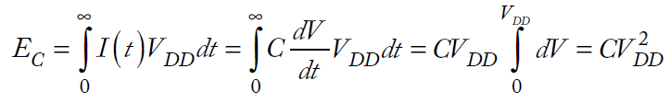
Dynamic Power Dissipation
Figure A shows a CMOS inverter driving a load capacitance. When the input switches from 1 to 0, the pMOS transistor turns ON and charges the load to VDD. According to EQ (6), the energy stored in the capacitor is
……………(7)
The energy delivered from the power supply is
…..(8)
Observe that only half of the energy from the power supply is stored in the capacitor. The other half is dissipated (converted to heat) in the pMOS transistor. The power dissipated depends only on the load capacitance, not on the size of the transistor or the speed at which the gate switches

Slide 22
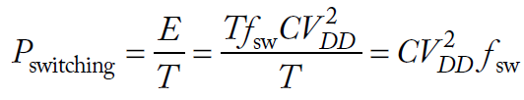

Continue…..
Suppose that the gate switches at some average frequency fsw. Over some interval T,
the load will be charged and discharged Tfsw times. Then, according to EQ (3), the
average power dissipation is
…………..(9)
This is called the dynamic power because it arises from the switching of the load. Because most gates do not switch every clock cycle, it is often more convenient to express switching frequency fsw as an activity factor α times the clock frequency f. Now, the dynamic power dissipation may be rewritten as
…………(10)
The activity factor is the probability that the circuit node transitions from 0 to 1.
Rohit Lorenzo, VIT-AP

Slide 23
Short Circuit Power Dissipation
Short-circuit power dissipation occurs as both pull-up and pulldown networks are partially ON while the input switches. It increases as the input edge rates become slower because both networks are ON for more time.
However,it decreases as load capacitance increases because with large loads the output only switches a small amount during the input transition.

Slide 24


Continue…..
Under the (reasonable) assumption that the resulting current spikes can be approximated as triangles and that the inverter is symmetrical in its rising and falling responses, we can compute the energy consumed per switching period.
…..(11)
as well as the average power consumption
……..(12)

Slide 25


Problem 1
Calculate the amount of energy and power needed to charge and discharge the capacitance. The value of load capacitance is equal to 6 fF for a supply volatge of 2.5 V. Consider time t_{P} = 32.5 ps.
Solution

Slide 26
Problem2
A digital system-on-chip in a 1V 65 nm process (with 50 nm drawn channel lengths and λ = 25 nm) has 1 billion transistors, of which 50 million are in logic gates and the remainder in memory arrays. The average logic transistor width is 12λ and the average memory transistor width is 4 λ . The memory arrays are divided into banks and only the necessary bank is activated so the memory activity factor is 0.02. The static CMOS logic gates have an average activity factor of 0.1. Assume each transistor contributes 1fF/μm of gate capacitance and 0.8 fF/μm of diffusion capacitance. Neglect wire capacitance for now (though it could account for a large fraction of total power). Estimate the switching power when operating at 1 GHz.
Solution
There are (50 ×10⁶ logic transistors)(12λ )(0.025 μm/λ )((1 + 0.8) fF/ μm) =27 nF of logic transistors and (950 × 10⁶ memory transistors)(4λ)(0.025 μm/λ)((1 +0.8) fF/μm) = 171 nF of memory transistors. The switching power consumption is [(0.1)(27 × 10^{–9}) + (0.02)(171 × 10⁻⁹ ](1.0 V)²(10⁹ Hz) = 6.1 W.

Slide 27
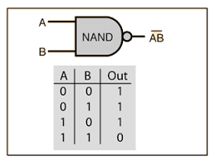

Switching Activity (α)
P₀ ₁ = P₀.P₁
P₀ = $\frac{1}{4}$ , P₁ = $\frac{3}{4}$
P₀ ₁ = $\frac{1}{4}$ ×$\frac{3}{4}$ = $\frac{3}{16}$
P₀ = $\frac{n0}{2n}$ , $n0$^{= No. of zeros}
P₁ = $\frac{n1}{2n}$ , n₁=(2^{n}-n₀)
P₀ ₁= P₀.P₁ =$\frac{n_{0}}{2^{n}}$×$\frac{{(2}^{n}−n_{0})}{2^{n}}$ =$\frac{n_{0}{(2}^{n}−n_{0})}{2^{2n}}$

Slide 28
Continue….
2 input Gates | inv | NAND/AND | NOR/OR
Activity | 1/4 | 3/16 | 3/16

Slide 29

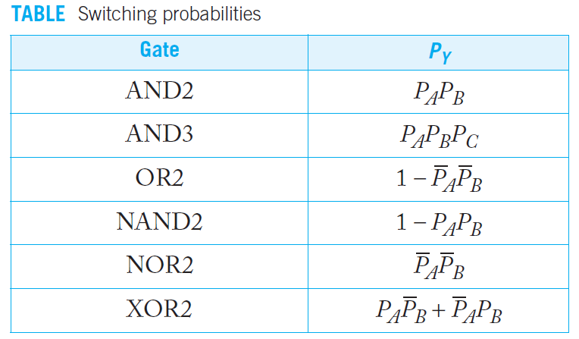
Continue….
The activity factor of a node is the probability that it switches from 0 to 1. This probability depends on the logic function. By analyzing the probability that each node is 1, we can estimate the activity factors.
Define P_{i} to be the probability that node i is 1. P_{i} = 1 – P_{i} is the probability that node i is 0. α_{i} , the activity factor of node i,

Slide 30
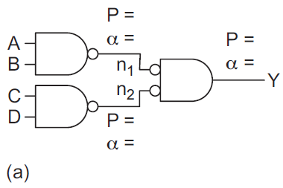
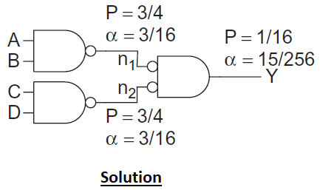
Problem3
Figure shows a 4-input AND gate built using a tree (a) and a chain (b) of gates. Determine the activity factors at each node in the circuit assuming the input probabilities PA = PB = PC = PD = 0.5.

Slide 31
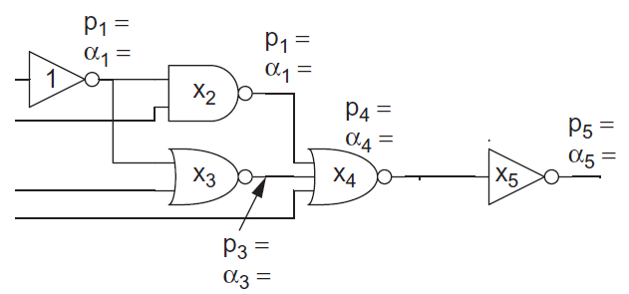
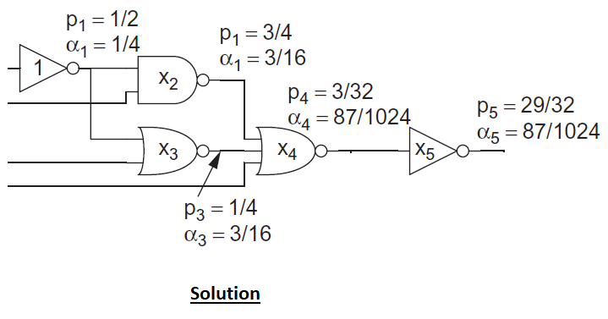
Problem4
Calculate probability and switching activity factor

Slide 32
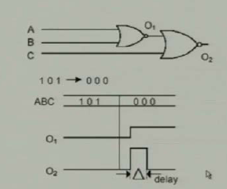
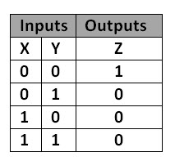
Glitching power Dissipation
The third source of dynamic power or dissipation is glitching power this glitching power dissipation occurs due to due to delay finite delay of the gate. because, of the finite delay of these gates there is a one the output is becoming high for a very small duration and this is known as glitch. So, there will be glitching power dissipation on this output capacitance.

Slide 33
Static Power (Leakage Power)
Static power is consumed even when a chip is not switching.
Prior to the 90 nm node, leakage power was of concern primarily during sleep mode because it was negligible compared to dynamic power.
In nanometer processes with low threshold voltages and thin gate oxides, leakage can account for as much as a third of total active power.

Slide 34
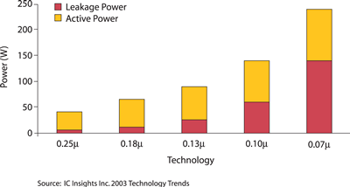
Why Leakage Power is Important
Leakage power increases at a faster rate than dynamic power in technology generation .
Leakage power is become a major component of total power dissipation
So there is need a methodology to reduce leakage power

Slide 35
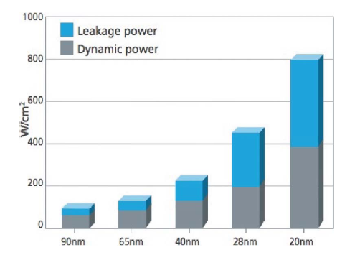
Continue…..
Power Density

Slide 36
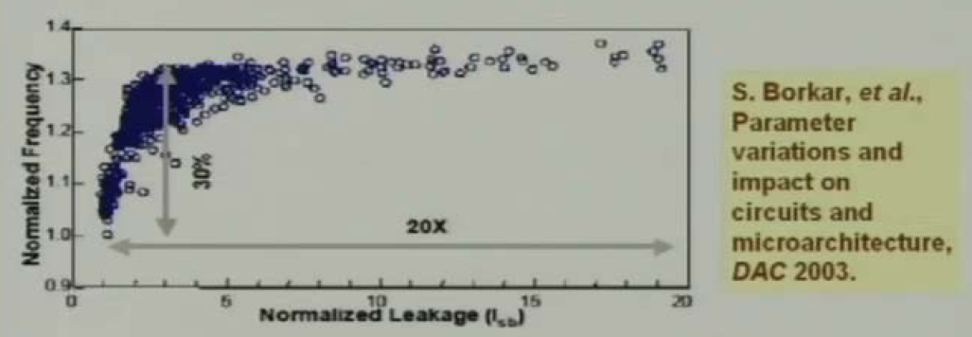
Impact of Process Variation on Leakage and Performance
30% delay variation and 20X leakage variation between fast and slow dies reported for 0.18μm CMOS process.
Low leakage chips with too low frequency must be discarded
High frequency chips with too high leakage must be discarded

Slide 37
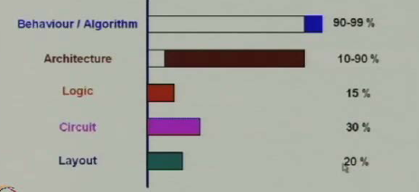
Power Dissipation at different levels
Power optimization approaches at the high level are significant since research results indicate that higher level of abstraction have greater potential for power reduction

Slide 38
Components of Leakage Power
I₁= Reverse diode leakage
I₂= Sub threshold leakage
I₃= Drain Induced barrier lowering
I₄= Gate Induced drain leakage
I₅= Channel punch through
I₆= Narrow Channel effect
I₇= Gate oxide tunneling
I₈= Hot Carrier Injection
Among all sub threshold leakage current is the dominant leakage current component
“K.Roy , S.mukhopadhyay and H.heimand ‘leakage current mechanism of deep-submicron CMOS circuits ,proc IEEE , vol 91 ,No.2 ,pp-305-327 , feb 01 , 2003”

Slide 39
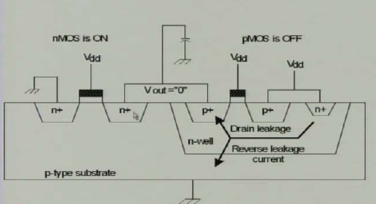
Reversed Biased Leakage

Slide 40
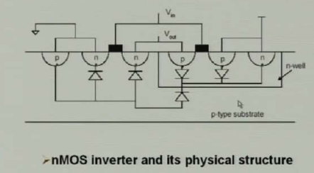
P-n Junction reverse biased Current

Slide 41
P-n Junction reverse biased Current
I_{D}=I_{s}(e^{-qv/KT} –1)
Where I_{s} is the reverse saturation current density
V = diode voltage
q = Charge of an electron
K = Boltzmann constant
T = Temperature in kelvin
The current is in the range of 0.1nA to 0.5nA per device at room temperature.
The current doubles for every 10⁰C rise in temperature.
However, this total static power due to diode leakage current for 1 million transistor is substantial.

Slide 42
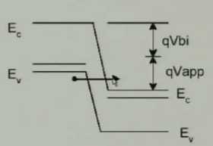
Band to band tunneling current
High electric field is across this reverse biased p-n junction diodes causes significant current known as band-to-band tunneling current.
This current dominates the p-n junction current

Slide 43

Subthreshold Leakage
Subthreshold leakage current flows when a transistor is supposed to be OFF.
where I_{off} is the subthreshold current at V_{gs} = 0 and V_{ds} = V_{DD .} S is the subthreshold
Slope. I_{off} is a key process parameter defining the leakage of a single OFF transistor. It is low for high V_{t} Transistor and high for low V_{t} Transistor. η is the DIBL coefficient.
Kγ is the body effect coefficient

Slide 44
Continue….
Various mechanism which effects the sub-threshold leakage current are-
Drain induced barrier lowering effect.
Body effect
Narrow width effect
Effect of channel length with Vth Roll off
Effect of temperature

Slide 45
Drain Induced Barrier Lowering (DIBL)
In long-channel devices, the source and drain are separated enough so that their depletion regions have no effect on the electrostatic potential developed across the channel.
Hence, for such devices, the V_{t} is virtually independent of the channel length and drain bias.
In a short-channel device, however, the source and drain depletion width in the vertical direction and the source drain potential have a strong effect on the band bending over a significant portion of the device.
Therefore, the V_{t} and consequently the sub-threshold current of short-channel devices, varies with the drain bias. This effect is referred to as drain induced barrier lowering (DIBL).

Slide 46
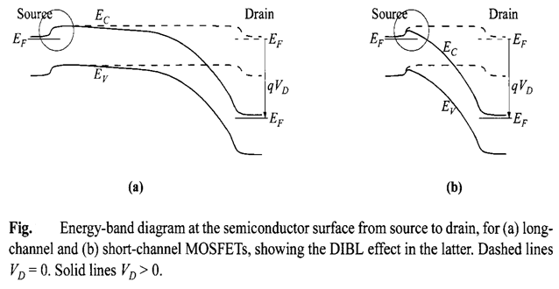
DIBL

Slide 47
Body Effect
As a negative voltage is applied to the substrate with respect to the source, the well to source junction the device is reverse biased and bulk depletion region is widened . This lead to increase in threshold voltage. This effect is known as Body effect.
Φ_{F} is the fermi potential.
γ is the body effect coefficient
V_{T0} is the threshold voltage at zero bias

Slide 48
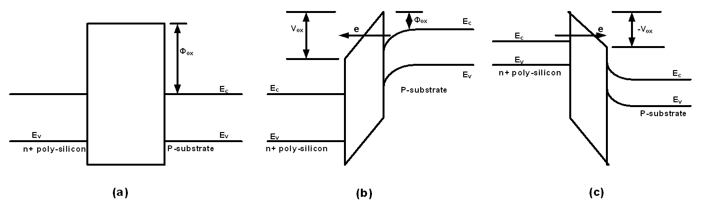
Gate oxide tunneling
Figure : Tunneling of electron through an MOS capacitor (a) Energy band diagram at flat-band condition. (b) Energy band diagram with positive gate bias showing tunneling of electron from substrate to gate. (c) Energy-band diagram at negative gate bias showing tunneling of electron from gate to substrate

Slide 49
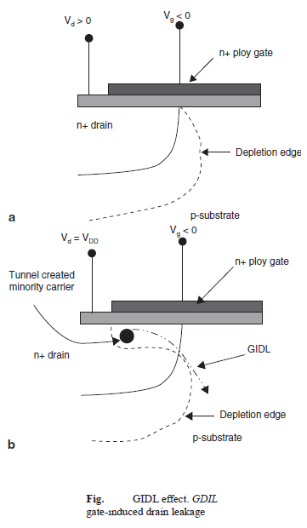
Gate-Induced Drain Leakage
Due to a high electric field (Vdg) across the oxide, a deep depletion region under the drain overlap region is created, which generates electrons and holes by band-to-band tunneling.
The resulting drain to body current is called GIDL current. When the negative gate bias is large ( v, gate at zero or negative voltages with respect to drain at Vdd), the n+ region under the gate can be depleted and even inverted as shown in Fig.
As a consequence, minority carriers are emitted in the drain region underneath the gate.
As the substrate is at a lower potential, the minority carriers at the drain depletion region are swept away laterally to the substrate, creating a GIDL current.
Thinner oxide thickness and higher Vdd enhance the electric field and therefore enhance GIDL current.

Slide 50
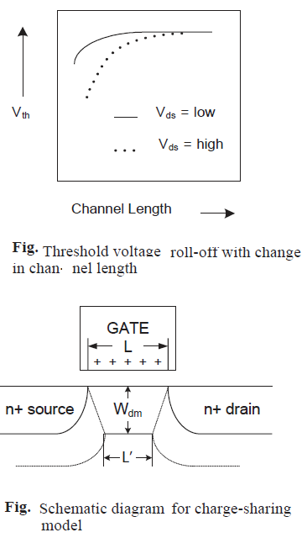

Vth Roll-Off
As the channel length is reduced, the threshold voltage of metal–oxide–semiconductor field-effect transistor (MOSFET) decreases.
This reduction of channel length is known as Vth roll-off. Figure shows the reduction of threshold voltage with a reduction in channel length.
The bulk change that needs to be inverted by the application of gate voltage is proportional to the area under the trapezoidal region
The gate voltage has to invert less bulk charge to turn the transistor on leading to more band bending in the Si–SiO2 interface in the short-channel device compared to long-channel devices.

Slide 51
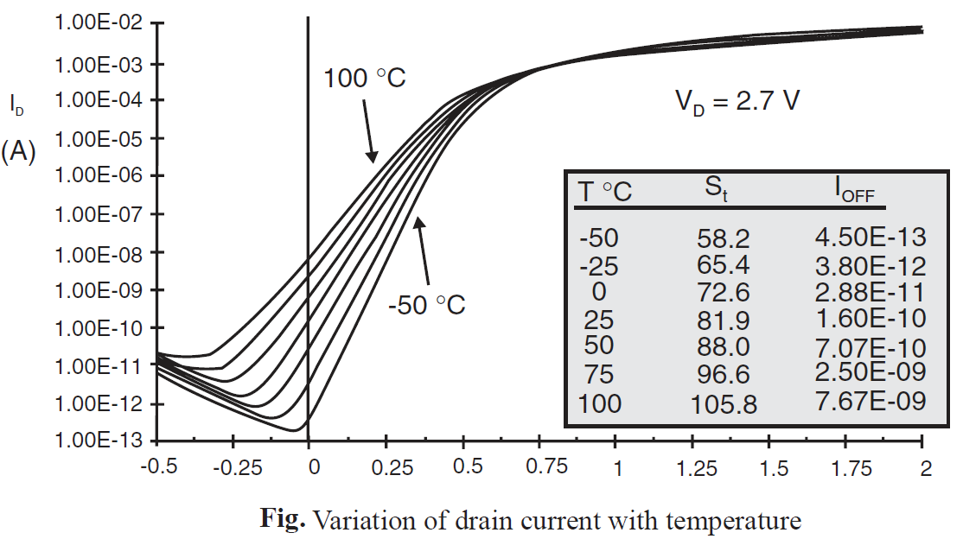
Temperature Effect
There is a strong dependence of threshold voltage on temperature.
The equation indicates that the subthreshold slope changes
linearly with temperature.
For a 0.3-μm technology, St varies from 58.2 to 81.9 mV/decade. As the temperature varies from − 50 to + 25 °C in the 0.3-μm technology as shown in Figure
The I_{OFF} increases from 0.45 to 100 pA, an increase by a factor of 356, for a 20-μm-wide device.The following two parameters are responsible for increases in subthreshold leakage current:
(i) St increases linearly with temperature.
(ii) The threshold voltage decreases with temperature at the rate of 0.8 mV/°C.

Slide 52
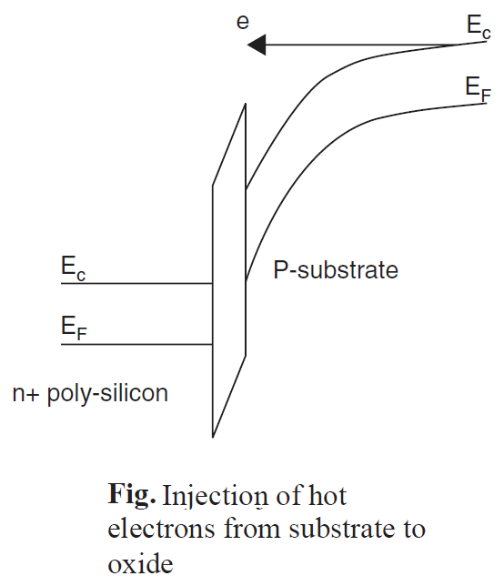
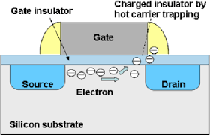
Hot-Carrier Injection
Electrons and holes near the Si–SiO₂ interface can gain sufficient energy due to the high electric field in short-channel MOSFETs and cross the interface potential barrier and enter into the oxide layer as shown in Fig.
This phenomenon is known as the hot-carrier injection. Because of the lower effective mass and smaller barrier height (3.1 eV) for electrons compared to holes (4.5 eV), the possibility of an injection due to electrons is more than the holes.

Slide 53
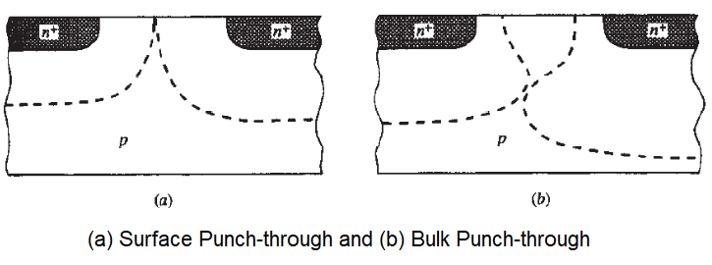
Punch Through
The drain and source regions are very much close to each other in short channel devices. The depletion region across the drain-substrate and source-substrate junction extends into the channel region.
The increase in V_{ds} further pushes the junction near to each other. Thus, the overall effect of short channel length and reverse biased substrate-drain junction leads to the merging of the two depletion regions, which cause punch through condition.

Slide 54
Problem
A digital system-on-chip in a 1V 65 nm process (with 50 nm drawn channel lengths and λ = 25 nm) has 1 billion transistors, of which 50 million are in logic gates and the remainder in memory arrays. The average logic transistor width is 12λ and the average memory transistor width is 4 λ .Subthreshold leakage for OFF devices is 100 nA/μm for low-threshold devices and 10nA/ μm for high-threshold devices. Gate leakage is 5nA/ μm. Junction leakage is negligible. Memories use low leakage devices everywhere. Logic uses low-leakage devices in all but 5% of the paths that are most critical for performance. Estimate the static power consumption
Solution
There are (50×10⁶ logic transistors)(0.05)(12λ)(0.025 μm/ λ) = 0.75 ×10⁶ μm of low-threshold devices and [(50×10⁶ logic transistors)(0.95)(12λ)+(950×10⁶memory transistors)(4λ)](0.025 μm/λ) = 109.25×10⁶ μm of high-threshold devices.
I_{sub} =[(0.75× 10⁶ μm)(100 nA/ μm) + (109.25× 10⁶ μm)(10 nA/μm)]/2 = 584 mA. Igate =((0.75 + 109.25) ×10⁶ μm)(5 nA/ μm)/2 = 275 mA. P_{static} = (584 mA + 275 mA)(1 V)= 859 mW.

Slide 55


The Power-Delay Product, or Energy per Operation
The power-delay product (PDP) as a quality measure for a logic gate
The PDP presents a measure of energy, as is apparent from the units (Wsec = Joule). Assuming that the gate is switched at its maximum possible rate of f_{max} = 1/(2t_{p}). The power delay product can be written as –
The PDP stands for the average energy consumed per switching event

Slide 56
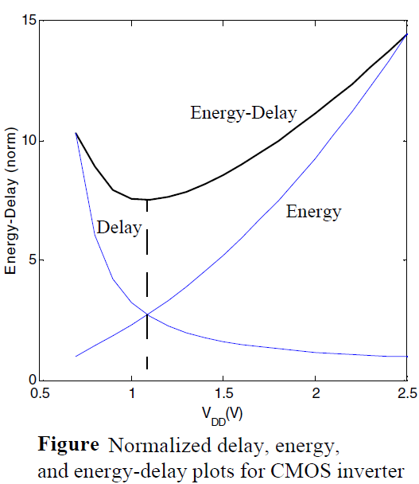

Energy Delay Product
The validity of the PDP as a quality metric for a process technology or gate topology is questionable. It measures the energy needed to switch the gate, which is an important property for sure.
A more relevant metric should combine a measure of performance and energy. The energy-delay product (EDP) does exactly that.
It is worth analyzing the voltage dependence of the EDP.
Higher supply voltages reduce delay, but harm the energy,
and the opposite is true for low voltages.

Slide 57
Thank You

